Slide 1
PV Access Introduction
EPICS Collaboration Meeting
Slovenia, Sept. 2022
Kay Kasemir

Slide 2
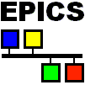
What is EPICS?
Network Diagram
Network Diagram (new)
Network Protocol plays central role
“Integrate into EPICS” = “Make accessible on Network”

Slide 3
EPICS Network Protocols
Channel Access
Since beginning of EPICS
DBR_*: Numbers, enums, string, scalar and array, with time, alarm, limits
Still fully supported
PV Access
Started as “EPICS V4” development
PV Data: Arbitrary structures
Since EPICS 7 (Dec. 2017) included in EPICS base

Slide 4
History
CAJ (pure Java)
RSRV Server in IOC, Client in IOC and on Host, K&R C then ANSI-C
Bindings for tcl, perl, python, matlab, java, …
EpicsSharp (pure C#)
PCAS Server for Host, C++
Caproto (pure python)
Channel Access
PV Access
pvaPy binding
Pvxs C++ update
Original
pvData/pvAccess C++ & Java implementation
p4p
QSRV server for IOC
core-pva Java update
incomplete, not to scale, to be continued

Slide 5
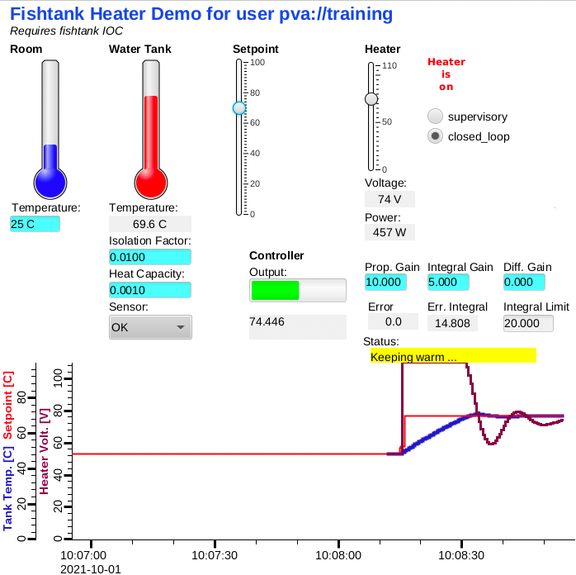
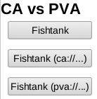
First Glance
softIoc vs. softIocPVA
# Compare CA-only example: cd /ics/examples/02_fishtank cat st.cmd # .. with this one: cd /ics/examples/24_pvaccess cat st.cmd ./st.cmd
pv… instead of ca…
camonitor training:setpoint training:tank pvmonitor training:setpoint training:tank pvput training:setpoint 40 caput training:setpoint 30
CS-Stud﻿io:
css -resource /ics/examples/24_pvaccess/pva.bob

Slide 6
PV Access
Similar to Channel Access
Name search via
UDP Broadcast (IPv4), Multicast or Unicast (IPv4, IPv6), configured via EPICS_PVA_ADDR_LIST, EPICS_PVA_AUTO_ADDR_LIST
TCP search via EPICS_PVA_NAME_SERVERS
Connection for data transfer via TCP
Same “channel” or “PV” abstraction from ”record”
Get, put, monitor
Plus an ‘RPC’ type operation

Slide 7
Channel Access vs. PV Access
Similar command line tools:
caget training:tank
camonitor training:tank
cainfo training:tank
caget –d CTRL_DOUBLE training:tank # Not supported camonitor –d CTRL_DOUBLE training:tank
caget training:tank.SCAN
pvget training:tank
pvmonitor training:tank
pvinfo training:tank pvget –M raw training:tank
# Note first few updates! pvmonitor –M raw training:tank
pvget training:tank.SCAN

Slide 8
CS-Studio
Use pva://… prefix to select PV Access
Use ca://… prefix to select Channel Access
Set default in /ics/tools/phoebus/settings.ini

Slide 9
How to add PVA to IOC?
Use softIocPVA
Start with `makeBaseApp.pl –t example`
Add to your own makeBaseApp-type Makefile: myioc_DBD += PVAServerRegister.dbd myioc_DBD += qsrv.dbd myioc_LIBS += qsrv myioc_LIBS += $(EPICS_BASE_PVA_CORE_LIBS)
Either way adds PVA and keeps CA

Slide 10
So it’s very similar, maybe more efficient…
What’s really new?
How about those custom structures?

Slide 11
Custom Data: Great, but then what?
Keith’s structure: short level double data string type time stamp …
Jürgen’s structure: short grad double wert string typ long zeit …
Fred’s structure: double value short status short severity string units time timeStamp …
Which number to show on a user display?
What units?
Is this an alarm?
Time stamp?
Jane’s structure: short info double content string meta long ms …

Slide 12
“Normative Types”
Channel Access
struct dbr_ctrl_double: short status short severity short precision char units[8] … no timestamp … double value struct dbr_time_double: short status short severity timestamp stamp double value
You get what you request (network always transfers complete struct)
PV Access
epics:nt/NTScalar: double value short status short severity string units time timeStamp …
You get what you request (but network only transfers changes)
Same record vs. PV abstraction.
There is no “NTRecord” or “NTCalcOut” that would fetch all fields of a record

Slide 13
Reminder: Channels/PVs vs. Records
Records have fields
Channels/PVs have properties
IOC maps fields of records to properties of channel/PV
VAL → value
TIME → timestamp
STAT & SEVR → alarm
EGU → Units
PREC → display hints
HIGH → upper warning threshold
Nearly every record.FIELD can become a PV: caget xxx
caget xxx.VAL caget xxx.EGU Detailed mapping of fields to channel/PV depend on record

Slide 14
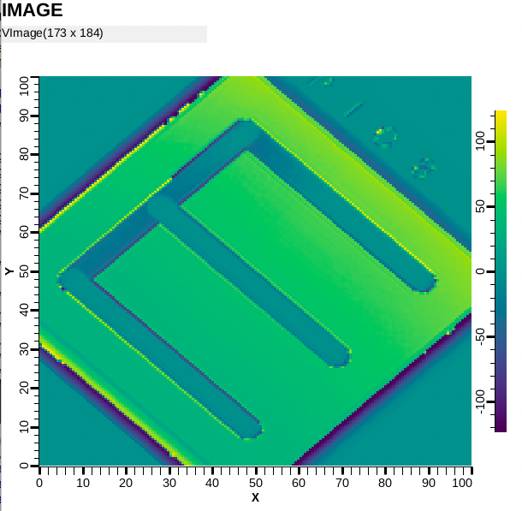
Images: Normative type NTNDArray
Standalone Demo Image cd /ics/examples/24_pvaccess ./start_imagedemo
CS-Studio Image widget
Only needs pva://IMAGE
css -resource /ics/examples/24_pvaccess/PVA_IMAGE.bob

Slide 15
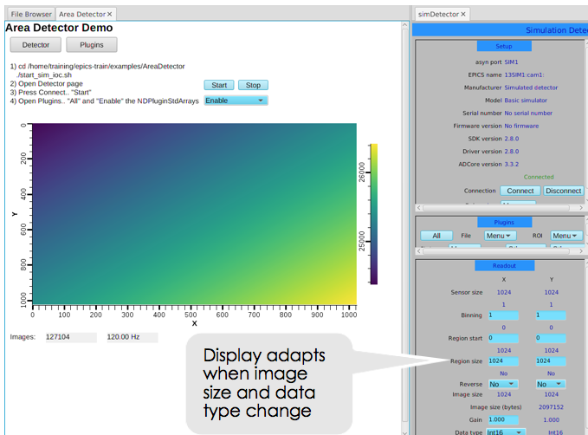
Images: Area Detector
Area Detector with “Sim” and NDPluginPVA cd /ics/examples/AreaDetector ./start_sim_ioc.sh
CS-Studio: Image widget
Just “pva://….:Image
”Limits from PV” option
css –resource /ics/examples/AreaDetector/0_AreaDetectorDemoPVA.bob

Slide 16
Area Detector Demo
“Start” Sim Detector, “Enable” PVA Plugin
Open display in editor to check Image widget config
Simple config via PV Name, maybe Limits from PV option
Data size, Color Mode, Unsigned are not needed!
Open “Detector” page, change “Region Size”, “Reverse”, “Data Type”
Image updates accordingly!
Open “Plugins”
Enable “NDPluginCodec”
Read SIM1
Select “LZ4” compressor, note “Compression Factor”
Set NDPluginPva to use Port “CODEC1”
Verify via `pvget 13SIM1:Pva1:Image`
Set Sim Data Type back to UInt8, then compress with “JPEG” of Quality 10
Compression support (LZ4 and JPEG)!

Slide 17
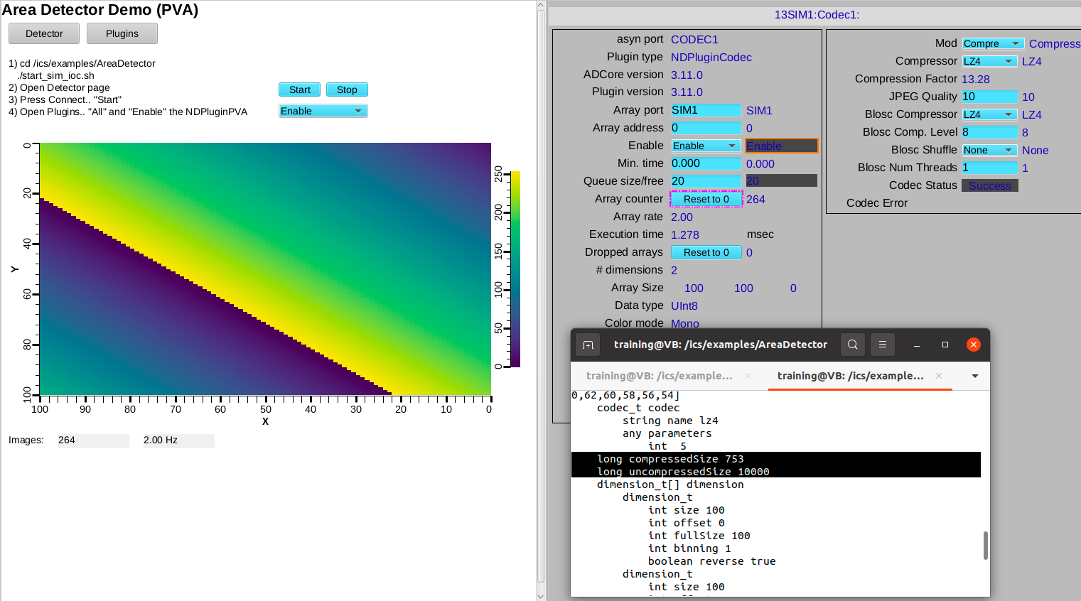
Image Compression

Slide 18
Custom PV Data
SNS Beam Lines started to use this in ~2014
cd /ics/examples/24_pvaccess ./start_neutrondemo -h ./start_neutrondemo -d 0.5 -r -m
pvinfo neutrons pvmonitor neutrons
Allows fetching just what’s needed:
# For detector pixel display pvget -r 'field(pixel)' neutrons pvmonitor -r 'field(timeStamp, pixel)' neutrons
# For energy displays pvmonitor -r 'field(time_of_flight, pixel)' neutrons

Slide 19
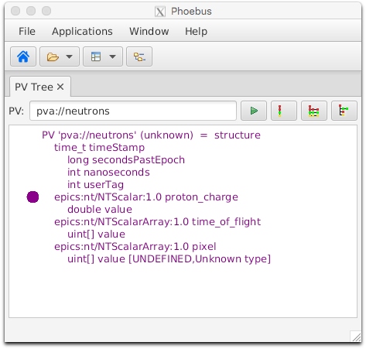
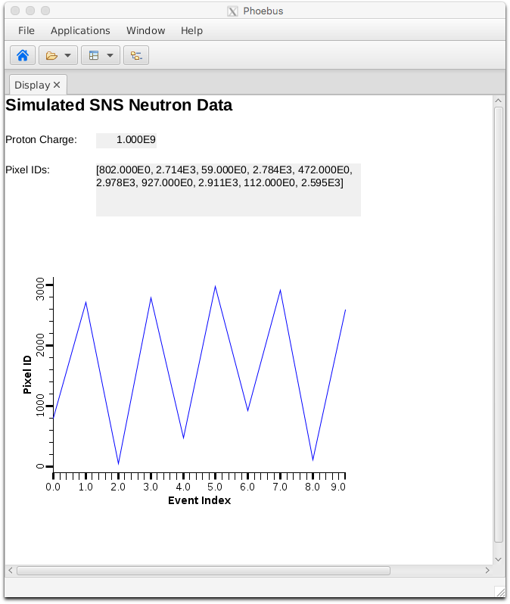
Custom PV Data in CS-Studio
Cannot handle arbitrary structure
pva://neutrons
Can handle fields which are scalar or array
pva://neutrons/proton_charge
pva://neutrons/pixel
css –resource /ics/examples/24_pvaccess/PVA_Neutrons.bob

Slide 20
History: Two compatible Implementations
Initial Implementation (Since ~2014)
C++: pvDataCPP, pvAccessCPP, …
Java: pvDataJava, pvAccessJava, …
Python: pvaPy
Gateway: pva2pva
Included in EPICS 7: softIocPVA, ‘QSRV’, pvget/put/info/monitor
Used in successful operation
Same API for C++ & Java: Lowest common denominator, missing language advantages.
Bugfixes, but no additions.
Updated Implementation (~2020)
C++: PVXS
Java: core-pva
Python: p4p
Gateway: p4p gateway
APIs take advantage of each language
Gateway’s “fair” scheduling helps with arrays; known UDP port allows use via firewalls
Active Development
IPv6 support
EPICS_PVA_NAME_SERVERS for TCP-only usage
Not in EPICS base, yet.
Same Protocol!

Slide 21
PV Access and Python
Basic ‘get’, ‘put’, ‘monitor’
PV Access server for normative types or custom data
See *.py examples under
cd /ics/examples/24_pvaccess
May have to use ‘python3’ since just ‘python’ is older version 2.x

Slide 22
Custom PV Data from IOC Records
`makeBaseApp.pl –t example` includes “group”, see /ics/examples/07_customApp/Db/circle.db, /ics/examples/iocBoot/ioc_custom
Calc records ..:circle:x & ..:circle:y compute (x, y) coordinate on circle
info() annotations create PV ”training:circle” PV as struct { angle, x, y }
PVA “training:circle” updates atomically
camonitor training:circle:x training:circle:y receives separate x, y updates pvmonitor training:circle will always see sqrt(x²+y²)==1
cd /ics/examples/24_pvaccess python circle.py

Slide 23
State of PV Access by late 2022
Done, operational
Server and client libraries for C++, Java, Python
2nd version
Area Detector image transfer
Used to distribute processing from camera hosts
Custom data servers and clients
SNS: neutron data
APS: services
Done, to be tested
PV server for records in IOC
All record types
‘Description’
Full ‘units’
Full 64 bits for ‘int64in’, ‘int64out’
No enum state limit
Supports changing metadata
CS-Studio client
Gateway
To do
IOC links
Default to CA. Initial support for field(INP, {pva:{pv:”tgt”}})
Channel Access Get/put callback → ??
How to best combine data from records into custom PVA data?

Slide 24
Summary: PV Access is ..
Alternative to Channel Access
Both can be used in parallel
Similar, but supports custom data types
Already useful for images and site-specific cases
Since EPICS 7 included in base IOC
Details of ‘group’, ‘field(…)’ access still evolving

